Slide 1
Machine Learning library in Haskell
Divyanshu Bhartiya (10250)
Deepak Pathak (10222)
Vineet Hingorani (Y9227654)
Rahul Ajmera (Y9451)

Slide 2
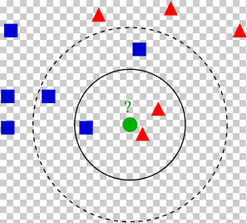
KNN Classifier
K-Nearest Neighbor classification
a method for classifying objects based on closest training examples in the feature space
the function is only approximated locally
distance metric used is “Euclidean distance”
number of neighbors can be altered

Slide 3
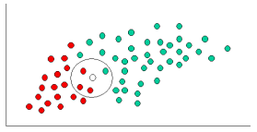
Naive Bayes Classifier
Probabilistic classifier based on Bayes’ theorem
Independent feature model
prob of a category * prob of feature to be in category
maximum prob for a category gives the resultant category
Feature space can be multi-dimensional
Distribution can be guassian/poisson

Slide 4
Latent Semantic Analysis
Technique of Natural Language Procesing
Vectorial semantics and dimensionality reduction
Analyzes relationships betweens terms and documents
Create a term by document matrix with tfidf scores
SVD decomposition of matrix
Reduce it to ‘n’ topics
Get respective vector of terms and documents

Slide 5
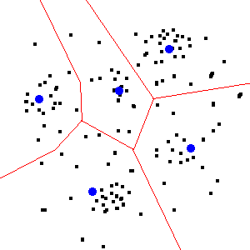
K-Means clustering
Distance metric is “Euclidean Distance”
Divides observations into k-sets
Centroids are used to identify cluster
Associate all points with nearest centroid out of k points

